Slide 1
Algorithm
A finite set of steps that must be followed to solve any problem is called an algorithm.
Algorithm is generally developed before the actual coding is done.
It is written using English like language so that it is easily understandable even by non-programmers.
Sometimes algorithms are written using pseudo codes, i.e. a language similar to the programming language to be used. Writing algorithm for solving a problem offers these advantages −

Slide 2
Writing algorithm for solving a problem offers these advantages −
Promotes effective communication between team members
Enables analysis of problem at hand
Acts as blueprint for coding
Assists in debugging
Becomes part of software documentation for future reference during maintenance phase
These are the characteristics of a good and correct algorithm −
Has a set of inputs
Steps are uniquely defined
Has finite number of steps
Produces desired output

Slide 3
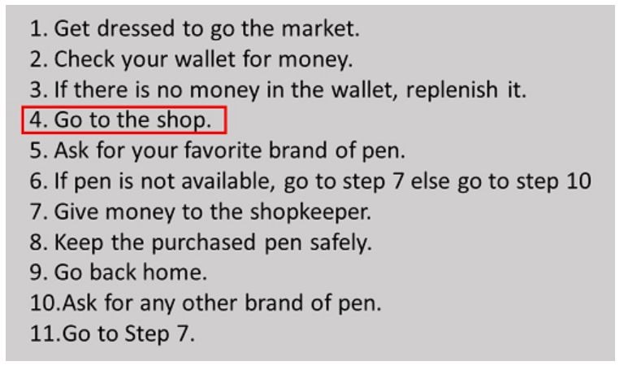
Ex : Algorithm
Let us first take an example of a real-life situation for creating algorithm. Here is the algorithm for going to the market to purchase a pen.

Slide 4
Algorithm 1: Add two numbers entered by the user
Step 1: Start
Step 2: Declare variables num1, num2 and sum.
Step 3: Read values num1 and num2.
Step 4: Add num1 and num2 and assign the result to sum.
sum←num1+num2
Step 5: Display sum
Step 6: Stop

Slide 5
Algorithm 2: Find the largest number among three numbers
Step 1: Start
Step 2: Declare variables a,b and c.
Step 3: Read variables a,b and c.
Step 4: If a > b
If a > c
Display a is the largest number.
Else
Display c is the largest number.
Else If b > c
Display b is the largest number.
Else
Display c is the greatest number.
Step 5: Stop

Slide 6
Advantages of Algorithms:
It is a step-wise representation of a solution to a given problem, which makes it easy to understand.
An algorithm uses a definite procedure.
It is not dependent on any programming language, so it is easy to understand for anyone even without programming knowledge.
Every step in an algorithm has its own logical sequence so it is easy to debug.
By using algorithm, the problem is broken down into smaller pieces or steps hence, it is easier for programmer to convert it into an actual program.

Slide 7
Disadvantages of Algorithms:
Algorithms is Time consuming.
Difficult to show Branching and Looping in Algorithms.
Big tasks are difficult to put in Algorithms.

Slide 8
Characteristics of Algorithms:
Precision – the steps are precisely stated(defined).
Uniqueness – results of each step are uniquely defined and only depend on the input and the result of the preceding steps.
Finiteness – the algorithm stops after a finite number of instructions are executed.
Input – the algorithm receives input.
Output – the algorithm produces output.
Generality – the algorithm applies to a set of inputs.

Slide 9
Flowchart
A flowchart is a type of diagram that represents a workflow or process.
A flowchart can also be defined as a diagrammatic representation of an algorithm, a step-by-step approach to solving a task.
The flowchart shows the steps as boxes of various kinds, and their order by connecting the boxes with arrows.
This diagrammatic representation illustrates a solution model to a given problem.
Flowcharts are used in analyzing, designing, documenting or managing a process or program in various fields.
A flowchart is a blueprint that pictorially represents the algorithm and its steps.

Slide 10
Benefits of Flowchart
Simplify the Logic
As it provides the pictorial representation of the steps therefore, it simplifies the logic and subsequent steps.
Makes Communication Better
Because of having easily understandable pictorial logic and steps, it is a better and simple way of representation.
Effective Analysis
Once the flow-chart is prepared, it becomes very simple to analyze the problem in an effective way.
Useful in Coding
The flow-chart also helps in coding process efficiently, as it gives directions on what to do, when to do, and where to do. It makes the work easier.

Slide 11
Proper Testing
Further, flowchart also helps in finding the error (if any) in program
Applicable Documentation
Last but not the least, a flowchart also helps in preparing the proper document (once the codes are written).

Slide 12
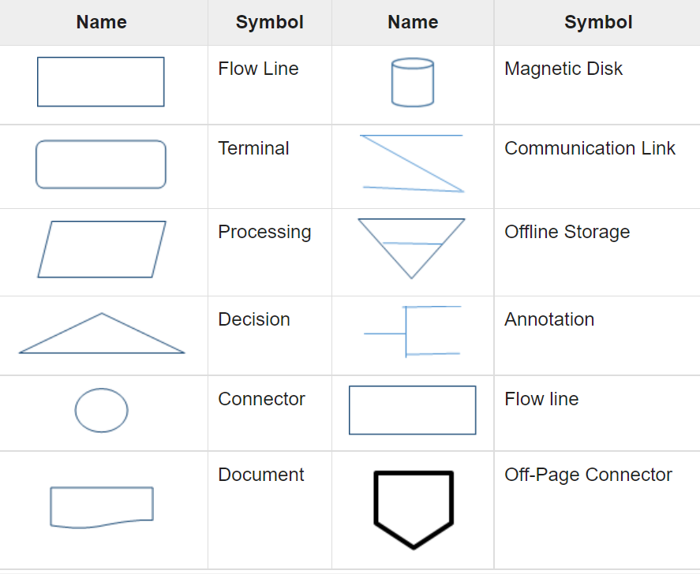
Flow-Chart Symbols

Slide 13
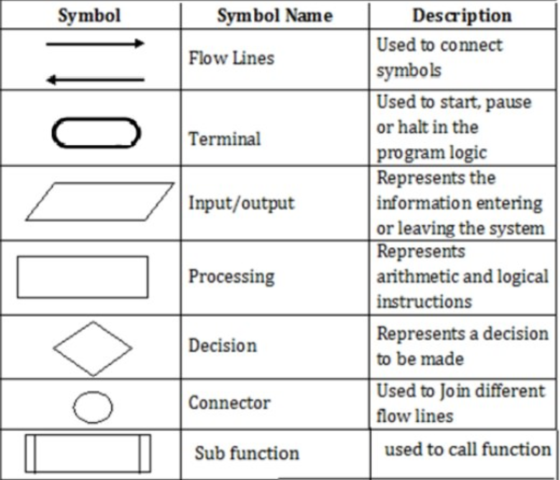

Slide 14
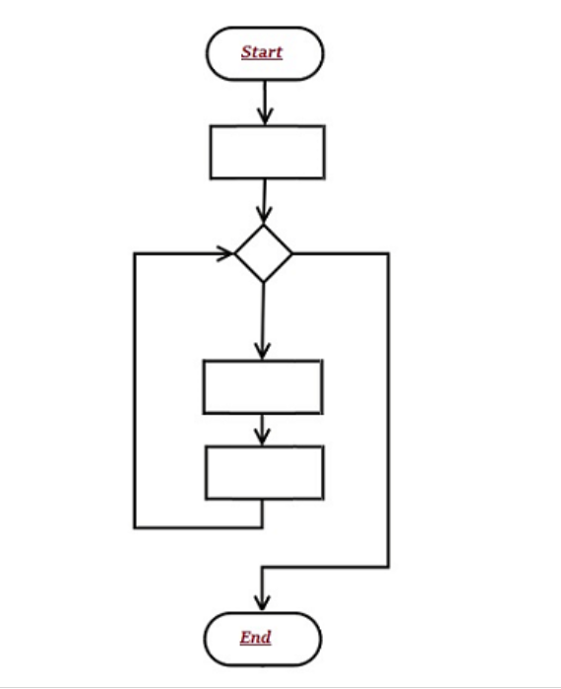
Pictorial Representation

Slide 15
Advantages Of FLOWCHARTS:
Communication: Flowcharts are better way of communicating the logic of a system to all concerned or involved.
Effective analysis: With the help of flowchart, problem can be analysed in more effective way therefore reducing cost and wastage of time.
Proper documentation: Program flowcharts serve as a good program documentation, which is needed for various purposes, making things more efficient.
Efficient Coding: The flowcharts act as a guide or blueprint during the systems analysis and program development phase.
Proper Debugging: The flowchart helps in debugging process.
Efficient Program Maintenance: The maintenance of operating program becomes easy with the help of flowchart. It helps the programmer to put efforts more efficiently on that part

Slide 16
Disadvantages FLOWCHARTS:
Complex logic: Sometimes, the program logic is quite complicated. In that case, flowchart becomes complex and clumsy. This will become a pain for the user, resulting in a waste of time and money trying to correct the problem
Alterations and Modifications: If alterations are required the flowchart may require re-drawing completely. This will usually waste valuable time.
Reproduction: As the flowchart symbols cannot be typed, reproduction of flowchart becomes a problem.

Slide 17
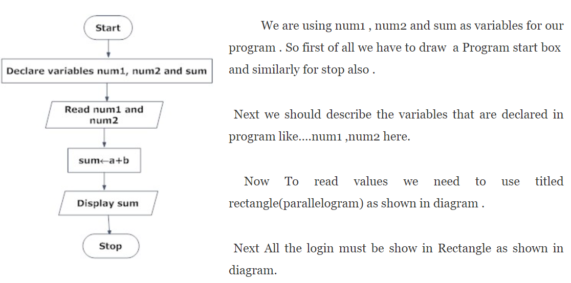
Example on Flow Charts for Programs

Slide 18
Pseudo Code with Example
What is Pseudo code
Pseudo code is a compact and informal high-level description of a program using the conventions of a programming language
Pseudo code is not an actual programming language. So it cannot be compiled into an executable program.
It uses short terms or simple English language syntaxes to write code for programs before it is actually converted into a specific programming language.

Slide 19
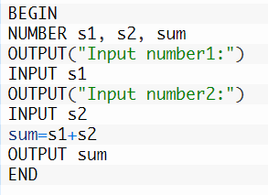
Ex: Add Two Numbers

Slide 20
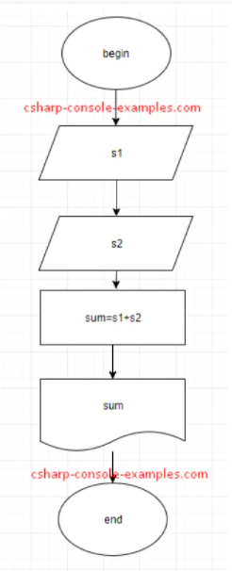

Slide 21
Algorithm on even/odd number
Step 1: Start
Step 2: [ Take Input ] Read: Number
Step 3: Check: If Number%2 == 0 Then
Print : N is an Even Number.
Else
Print : N is an Odd Number.
Step 4: Exit

Slide 22
Source code on even/odd number
int main()
{
int num;
printf("Enter an integer: ");
scanf("%d",&num);
if ( num%2 == 0 )
printf("%d is an even number", num);
else
printf("%d is an odd number", num);
return 0;
}

Slide 23
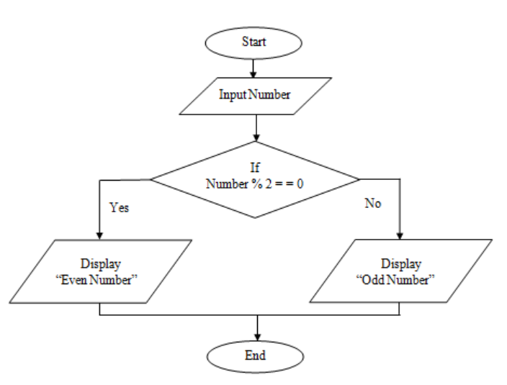
Flow chart on even/odd number

Slide 24
Algorithm on to find weather given number is Positive or Negative
START
Step 1 → Take integer variable A
Step 2 → Assign value to the variable
Step 3 → Check if A is greater than or equal to 0
Step 4 → If true print A is positive
Step 5 → If false print A is negative
STOP

Slide 25
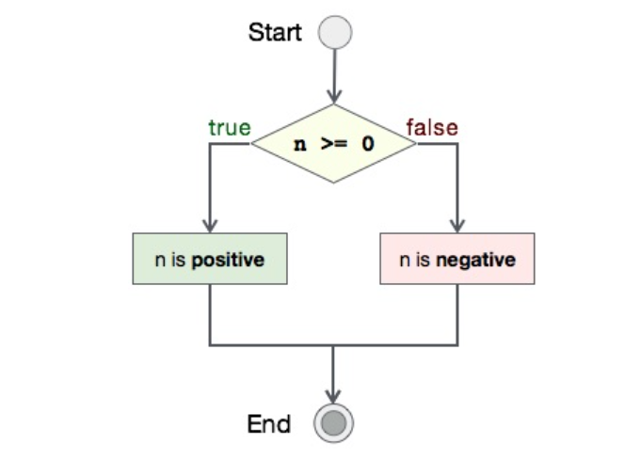
Flow Chart on given number is +ve or -ve

Slide 26
Source code
int main()
{
int number = 2;
if (number >= 0)
printf("%d is positive\n", number);
else
printf("%d is negative\n", number);
return 0;
}

